Slide 1

/
Lecture 5 Introduction to Statistical Inference

Slide 2
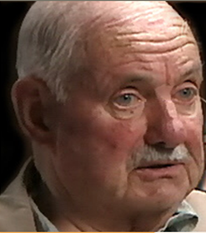
From last time:
Bob Edmonds purchased Lottery tickets on 7/13/2001
On 7/27/2001, Edmonds was told by a clerk that he had won a free ticket
Edmonds’ numbers had won $250,000 …
… but the clerk kept the original winning ticket and claimed it herself for $250,000

Slide 3

Edmonds reported the theft, but the Ontario Lottery and Gaming corporation took no action, and eventually Edmonds sued the OLG for negligence
It was alleged that “insider” employees – store owners and employees – were winning the “major prizes” (prizes worth $50,000 or more) at a much higher rate than could be explained by luck

Slide 4
From 1996 to 2006, “insider” employees bought 0.48% of tickets …
$ by insiders = (10,300 locations) x (3.2 insiders / location) x (68% play) x ($473.31 / year) = $10.7M
$ spent on lottery = 2,220,000,000
→ % sales to insiders = $10.7M / $2.22B = 0.0048
… and won 3.5% of the 5713 “major prizes”
P(“insiders” win 3.5% or more of 5713)
=P(win 200 or more of 5713 major prizes)
=1-BINOMDIST(199, 5713, 0.48%, TRUE)
= 0 [can be shown to be 1.04 x 10^{–99} ]

Slide 5
A formal way of stating the situation
IF “insider” employees were playing fairly, they should have won about 27.47 of the 5713 “major prizes”, give or take 5.23 or so
Insiders actually won 200 “major prizes”
The chance insiders would have won 200 or more “major prizes” by luck is ~10^{–99}
Conclusion: it wasn’t luck!
“absolutely impossible” by pure luck

Slide 6
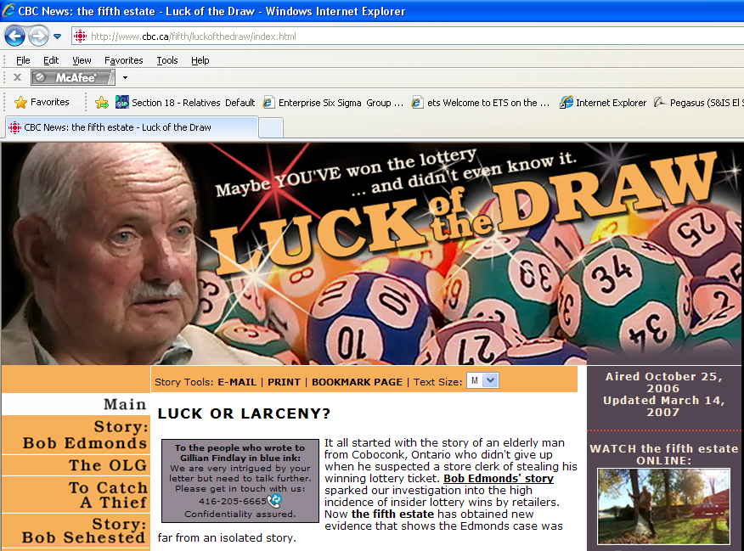

Slide 7
Bob Edmonds’ case is an example of “statistical inference”…

Slide 8
Some Definitions
Population … the entire set of interest
Populations can be finite or infinite / hypothetical
Parameter … a numerical fact about the population
Sample … a subset of the population
Random sample … a sample drawn such that every item had a known probability of being selected
Simple random sample … a random sample where every item had an equal probability of being selected
Sample statistic … numerical fact about the sample

Slide 9
Statistical inference is the process of applying probability to data from random samples to draw conclusions about unknown population parameters
Population = all “major prizes”, past and future
Parameter = probability / percentage of all major prizes that would be won by “insiders” (unknown)
Sample = set of 5713 “major prizes”
Statistic = observed percentage of wins by “insider employees” (3.5%)

Slide 10
Two types of statistical inference
Tests of statistical significance (aka hypothesis tests)
Seeing if the unknown population parameter might be equal to a certain value
Confidence intervals
Making “reasonable guesses” for the unknown population parameter

Slide 11
Two types of statistical inference
Tests of statistical significance (aka hypothesis tests)
Seeing if the unknown population parameter might be equal to a certain value
Confidence intervals
Making “reasonable guesses” for the unknown population parameter

Slide 12
Use a test of significance if you want to know whether results can be explained as being “just due to luck”
Lottery employees accounted for 0.48% of sales but 3.5% of the 5713 “major prizes” … could this just be due to luck?

Slide 13
Definitions for hypothesis testing
Null hypothesis … a statement that the data are due only to luck; must be equivalent to a statement about a parameter / random variable
Test statistic … a measure of how incompatible the data are with the null hypothesis; e.g., Z
p-value … the probability of getting new results AS or MORE EXTREME than the actual data, if the null hypothesis were true. If p is “small”, we reject the null hypothesis and say it’s not luck
“statistically significant” … if p-value < 0.05

Slide 14
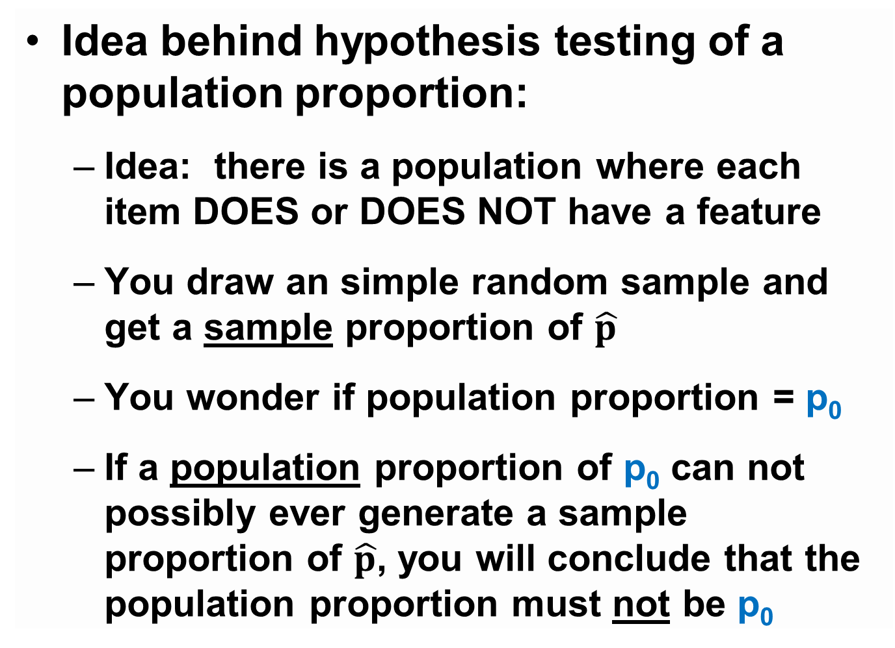
Idea behind hypothesis testing of a population proportion:
Idea: there is a population where each item DOES or DOES NOT have a feature
You draw an simple random sample and get a sample proportion of $\hat{p}$
You wonder if population proportion = p₀
If a population proportion of p₀ can not possibly ever generate a sample proportion of $\hat{p}$, you will conclude that the population proportion must not be p₀
is less than
5% likely to

Slide 15
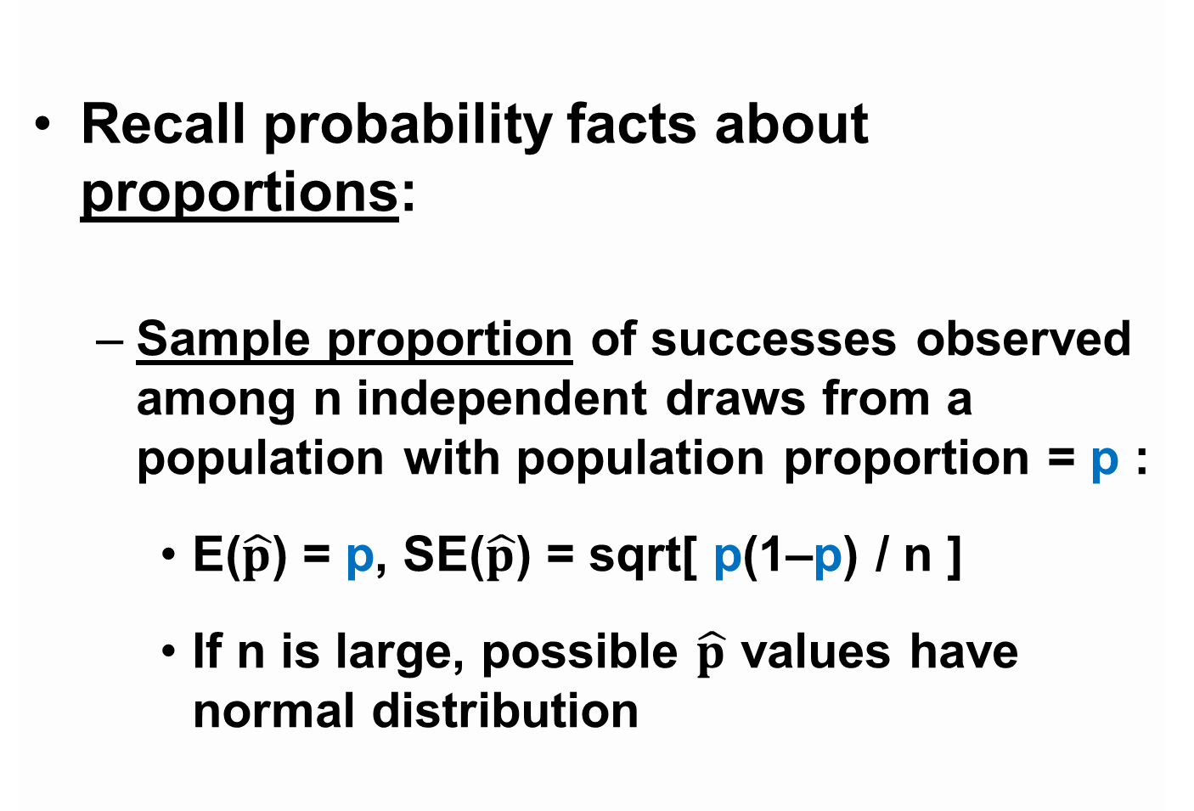
Recall probability facts about proportions:
Sample proportion of successes observed among n independent draws from a population with population proportion = p :
E($\hat{p}$) = p, SE($\hat{p}$) = sqrt[ p(1–p) / n ]
If n is large, possible $\hat{p}$ values have normal distribution

Slide 16
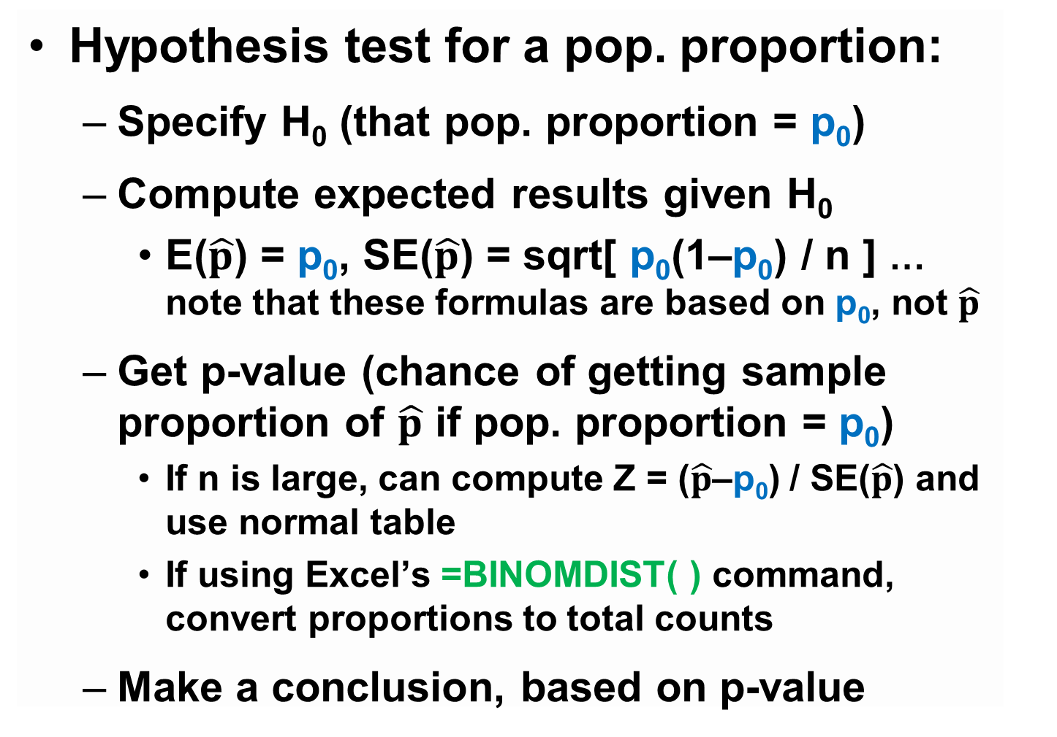
Hypothesis test for a pop. proportion:
Specify H₀ (that pop. proportion = p₀)
Compute expected results given H₀
E($\hat{p}$) = p₀, SE($\hat{p}$) = sqrt[ p₀(1–p₀) / n ] … note that these formulas are based on p₀, not $\hat{p}$
Get p-value (chance of getting sample proportion of $\hat{p}$ if pop. proportion = p₀)
If n is large, can compute Z = ($\hat{p}$–p₀) / SE($\hat{p}$) and use normal table
If using Excel’s =BINOMDIST( ) command, convert proportions to total counts
Make a conclusion, based on p-value

Slide 17
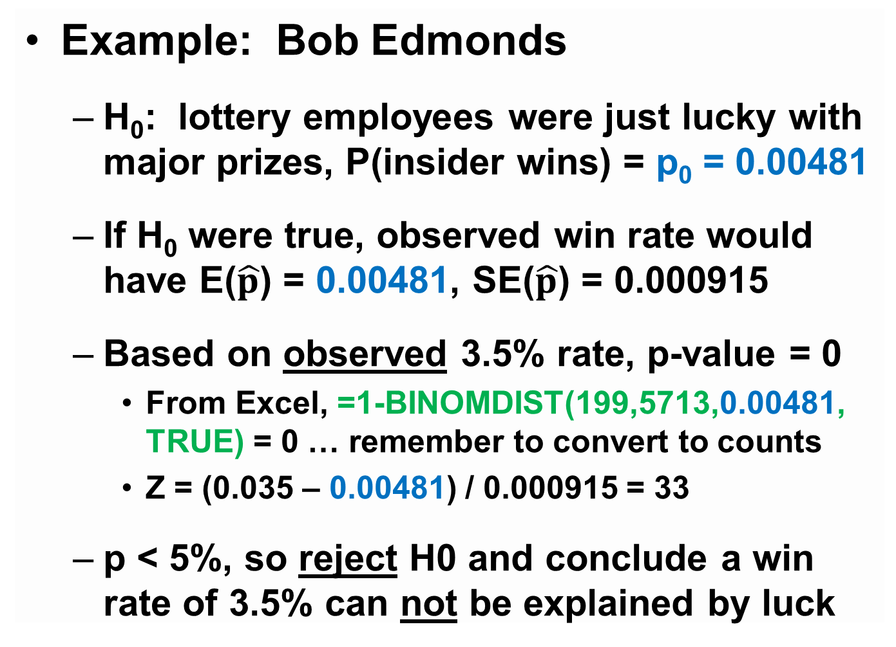
Example: Bob Edmonds
H₀: lottery employees were just lucky with major prizes, P(insider wins) = p₀ = 0.00481
If H₀ were true, observed win rate would have E($\hat{p}$) = 0.00481, SE($\hat{p}$) = 0.000915
Based on observed 3.5% rate, p-value = 0
From Excel, =1-BINOMDIST(199,5713,0.00481, TRUE) = 0 … remember to convert to counts
Z = (0.035 – 0.00481) / 0.000915 = 33
p < 5%, so reject H0 and conclude a win rate of 3.5% can not be explained by luck

Slide 18
OLG settled with Edmonds

Slide 19
Warning
p-value is not probability that H₀ is true
p-value is calculated assuming H₀ is true
p-values are “if-then” statements:
If the null hypothesis were true, then there would have been a p% chance to get results as or more extreme than what we actually got … if p is small, then the null hypothesis must not be true, since we DID get those results

Slide 20
http://www.publicpolicypolling.com/pdf/2011/PPP_Release_National_ConspiracyTheories_040213.pdf
PPP poll, 3/2013, SRS of n=1247 voters
“Do you believe shape-shifting reptilian people control our world by taking on human form and gaining political power to manipulate our societies, or not?”
Population … all adults in the US
Parameter … % of all American voters who believe in lizard people … parameter is unknown!
Sample … 1247 people interviewed, equiv. to SRS
Statistic … 50 out of 1247, or 4%

Slide 21
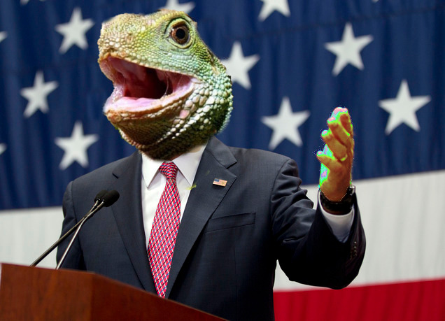
http://www.publicpolicypolling.com/pdf/2011/PPP_Release_National_ConspiracyTheories_040213.pdf
4% of U.S. voters (50 out of 1247) believe shape-shifting reptilian people are gaining political power to manipulate our societies
Q: could the population percentage be 10%?

Slide 22
http://www.publicpolicypolling.com/pdf/2011/PPP_Release_National_ConspiracyTheories_040213.pdf
H₀: the percentage of all voters who believe is p₀ = 0.10 (the reason we only got 4% is luck)

Slide 23
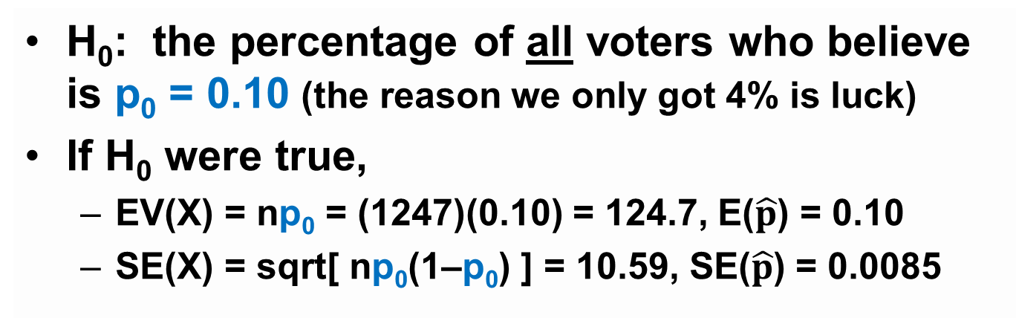
http://www.publicpolicypolling.com/pdf/2011/PPP_Release_National_ConspiracyTheories_040213.pdf
H₀: the percentage of all voters who believe is p₀ = 0.10 (the reason we only got 4% is luck)
If H₀ were true,
EV(X) = np₀ = (1247)(0.10) = 124.7, E($\hat{p}$) = 0.10
SE(X) = sqrt[ np₀(1–p₀) ] = 10.59, SE($\hat{p}$) = 0.0085

Slide 24

http://www.publicpolicypolling.com/pdf/2011/PPP_Release_National_ConspiracyTheories_040213.pdf
H₀: the percentage of all voters who believe is p₀ = 0.10 (the reason we only got 4% is luck)
If H₀ were true,
EV(X) = np₀ = (1247)(0.10) = 124.7, E($\hat{p}$) = 0.10
SE(X) = sqrt[ np₀(1–p₀) ] = 10.59, SE($\hat{p}$) = 0.0085
p-value
P(find 50 or fewer who believe) = BINOMDIST(50,1247,0.10,TRUE) = 2 x 10^{–15}

Slide 25

http://www.publicpolicypolling.com/pdf/2011/PPP_Release_National_ConspiracyTheories_040213.pdf
H₀: the percentage of all voters who believe is p₀ = 0.10 (the reason we only got 4% is luck)
If H₀ were true,
EV(X) = np₀ = (1247)(0.10) = 124.7, E($\hat{p}$) = 0.10
SE(X) = sqrt[ np₀(1–p₀) ] = 10.59, SE($\hat{p}$) = 0.0085
p-value
P(find 50 or fewer who believe) = BINOMDIST(50,1247,0.10,TRUE) = 2 x 10^{–15}
Normal approx:
Z = (50.5 – 124.7) / 10.59 = –7.00 → p = 1 x 10^{–12}
Z ~ (0.04 – 0.10) / 0.0085 = –7.06 → p = 8 x 10^{–13}

Slide 26

http://www.publicpolicypolling.com/pdf/2011/PPP_Release_National_ConspiracyTheories_040213.pdf
H₀: the percentage of all voters who believe is p₀ = 0.10 (the reason we only got 4% is luck)
If H₀ were true,
EV(X) = np₀ = (1247)(0.10) = 124.7, E($\hat{p}$) = 0.10
SE(X) = sqrt[ np₀(1–p₀) ] = 10.59, SE($\hat{p}$) = 0.0085
p-value
P(find 50 or fewer who believe) = BINOMDIST(50,1247,0.10,TRUE) = 2 x 10^{–15}
Conclusion: p-value < 0.05 → reject H₀
It is not the case that 10% of the U.S. population believes that shape-shifting reptilian people are taking on human form and gaining political power

Slide 27

http://www.publicpolicypolling.com/pdf/2011/PPP_Release_National_ConspiracyTheories_040213.pdf
H₀: the percentage of all voters who believe is p₀ = 0.10 (the reason we only got 4% is luck)
If H₀ were true,
EV(X) = np₀ = (1247)(0.10) = 124.7, E($\hat{p}$) = 0.10
SE(X) = sqrt[ np₀(1–p₀) ] = 10.59, SE($\hat{p}$) = 0.0085
p-value
P(find 50 or fewer who believe) = BINOMDIST(50,1247,0.10,TRUE) = 2 x 10^{–15}
Conclusion: p-value < 0.05 → reject H₀
It is not the case that 10% of the U.S. population believes that shape-shifting reptilian people are taking on human form and gaining political power
… what IS the percentage who believe that?

Slide 28
Two types of statistical inference
Tests of statistical significance (aka hypothesis tests)
Seeing if the unknown population parameter might be equal to a certain value
Confidence intervals
Making “reasonable guesses” for the unknown population parameter

Slide 29
Use a confidence interval if you want to know what guesses for the parameter could be considered “reasonable”
4% of U.S. voters believe reptilian people are gaining power … could it be as high as 5% of voters? 6%? 8%?

Slide 30
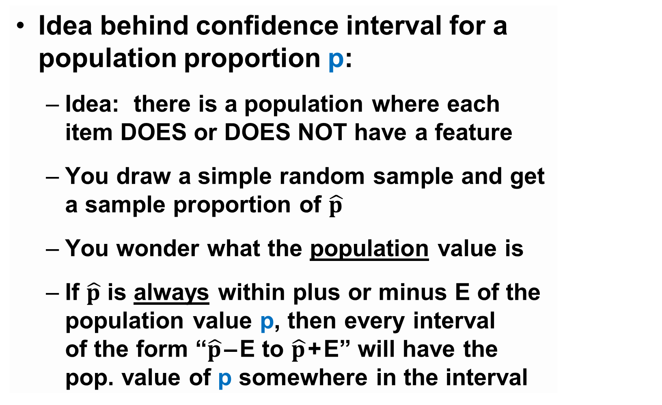
Idea behind confidence interval for a population proportion p:
Idea: there is a population where each item DOES or DOES NOT have a feature
You draw a simple random sample and get a sample proportion of $\hat{p}$
You wonder what the population value is
If $\hat{p}$ is always within plus or minus E of the population value p, then every interval of the form “$\hat{p}$ – E to $\hat{p}$ + E” will have the pop. value of p somewhere in the interval
usually
many intervals

Slide 31
A confidence interval for a parameter often depends on three values:
The POINT ESTIMATE (“best guess”) for the parameter, based on sample statistic
The STANDARD ERROR of the statistic
This is an estimate of how far the statistic is “usually” away from the population parameter
The CONFIDENCE level desired
Not all confidence intervals are correct … how often are you willing to make a mistake?

Slide 32
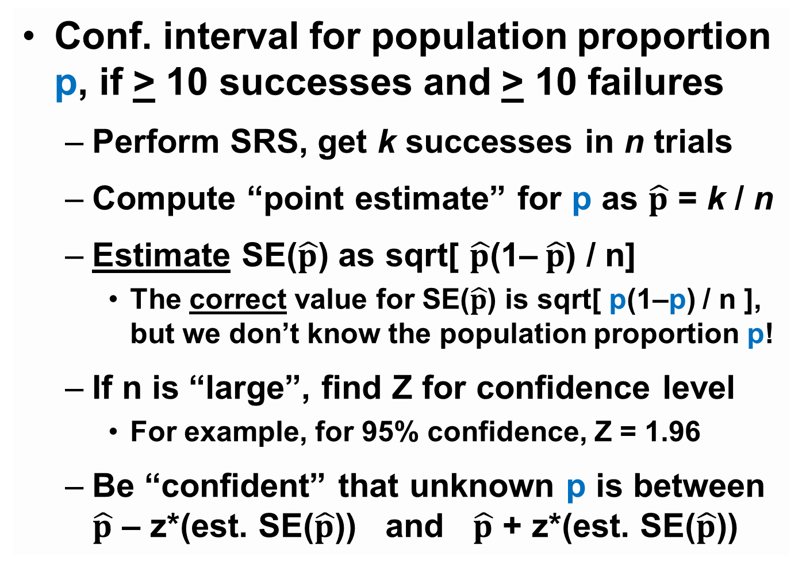
Conf. interval for population proportion p, if > 10 successes and > 10 failures
Perform SRS, get k successes in n trials
Compute “point estimate” for p as $\hat{p}$ = k / n
Estimate SE($\hat{p}$) as sqrt[ $\hat{p}$(1–$\hat{p}$) / n]
The correct value for SE($\hat{p}$) is sqrt[ p(1–p) / n ], but we don’t know the population proportion p!
If n is “large”, find Z for confidence level
For example, for 95% confidence, Z = 1.96
Be “confident” that unknown p is between $\hat{p}$ – z*(est. SE($\hat{p}$)) and $\hat{p}$ + z*(est. SE($\hat{p}$))

Slide 33
PPP poll, 3/2013, SRS of n=1247 voters, 50 believe in shape-shifting reptilians

Slide 34
95% confidence interval for p = percentage of all Americans who believe that reptilian people control our world:
PPP poll, 3/2013, SRS of n=1247 voters, 50 believe in shape-shifting reptilians

Slide 35
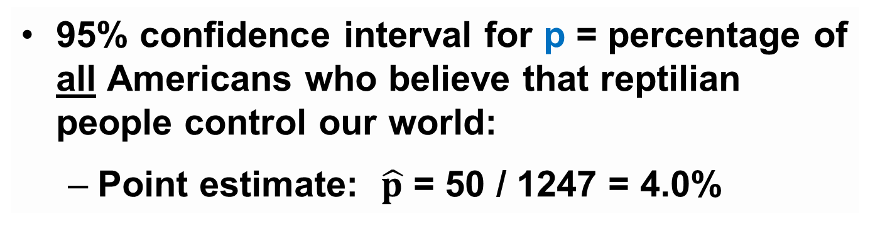
95% confidence interval for p = percentage of all Americans who believe that reptilian people control our world:
Point estimate: $\hat{p}$ = 50 / 1247 = 4.0%
PPP poll, 3/2013, SRS of n=1247 voters, 50 believe in shape-shifting reptilians

Slide 36
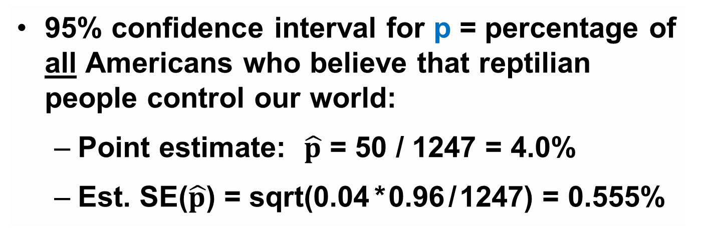
95% confidence interval for p = percentage of all Americans who believe that reptilian people control our world:
Point estimate: $\hat{p}$ = 50 / 1247 = 4.0%
Est. SE($\hat{p}$) = sqrt(0.04 * 0.96 / 1247) = 0.555%
PPP poll, 3/2013, SRS of n=1247 voters, 50 believe in shape-shifting reptilians

Slide 37

95% confidence interval for p = percentage of all Americans who believe that reptilian people control our world:
Point estimate: $\hat{p}$ = 50 / 1247 = 4.0%
Est. SE($\hat{p}$) = sqrt(0.04 * 0.96 / 1247) = 0.555%
95% confidence → Z = 1.96
PPP poll, 3/2013, SRS of n=1247 voters, 50 believe in shape-shifting reptilians

Slide 38

95% confidence interval for p = percentage of all Americans who believe that reptilian people control our world:
Point estimate: $\hat{p}$ = 50 / 1247 = 4.0%
Est. SE($\hat{p}$) = sqrt(0.04 * 0.96 / 1247) = 0.555%
95% confidence → Z = 1.96
95% confidence interval for p: 4.0% + (1.96)(0.555%), so 2.91% to 5.09%
PPP poll, 3/2013, SRS of n=1247 voters, 50 believe in shape-shifting reptilians

Slide 39
What does this statement mean?
“95% conf. interval for % of all voters who believe in lizard people is 2.9% to 5.1%”
It does not mean “there is a 95% chance that the percentage of all voters who believe in lizard people is between 2.9% and 5.1%”, because there is only one number for the percentage of all voters who believe
Instead, the 95% refers to the chance that the sample proportion (which is random) was “close to” the population parameter

Slide 40
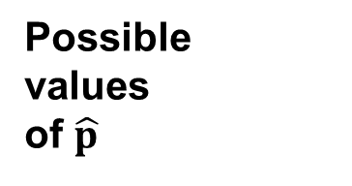
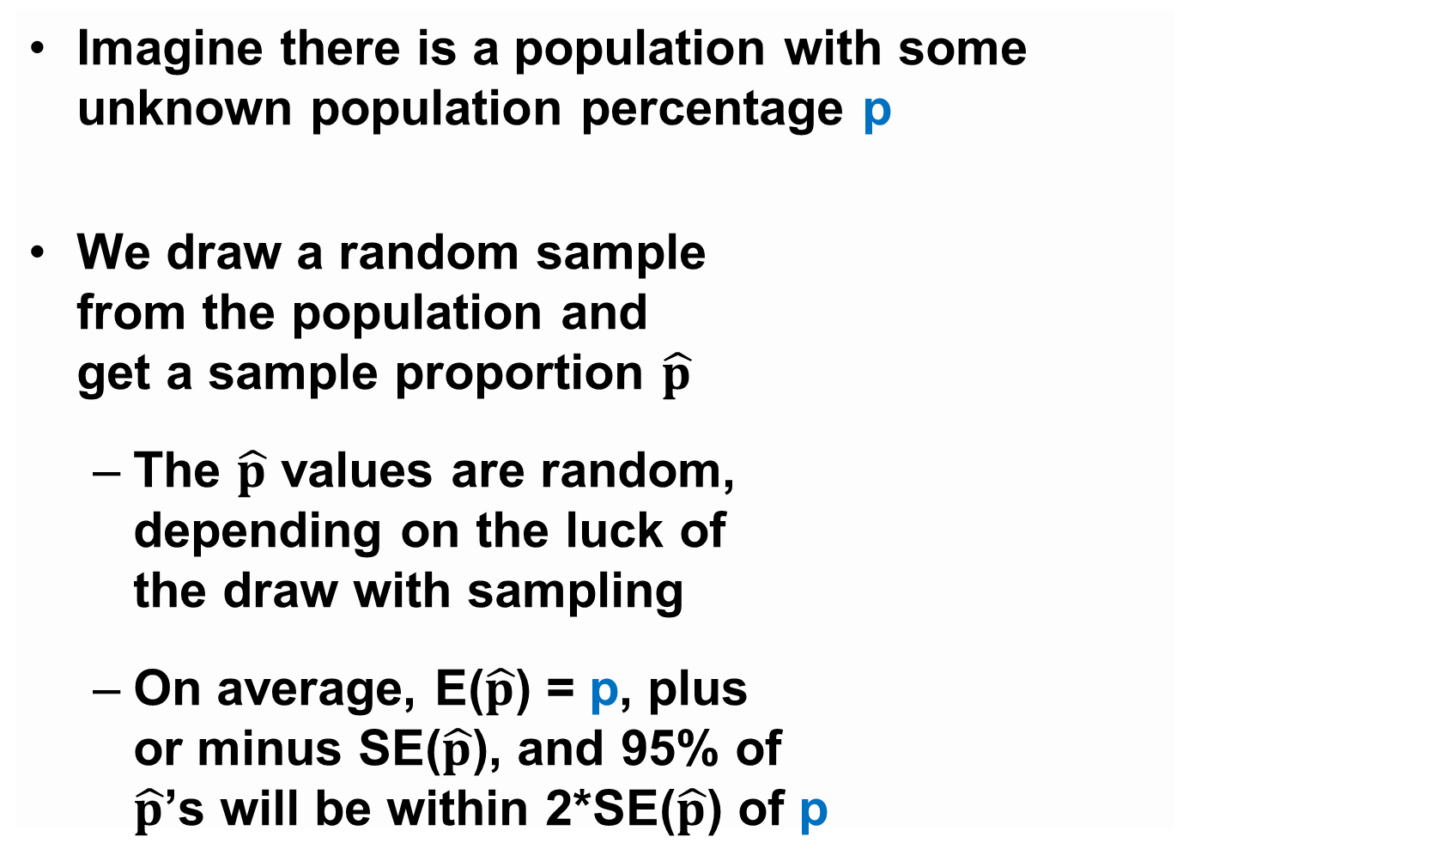
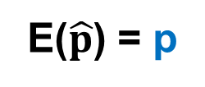
Imagine there is a population with some unknown population percentage p
We draw a random sample from the population and get a sample proportion $\hat{p}$
The $\hat{p}$ values are random, depending on the luck of the draw with sampling
On average, E($\hat{p}$) = p, plus or minus SE($\hat{p}$), and 95% of $\hat{p}$’s will be within 2*SE($\hat{p}$) of p
Possible values of $\hat{p}$
p
E($\hat{p}$) = p
95%

Slide 41
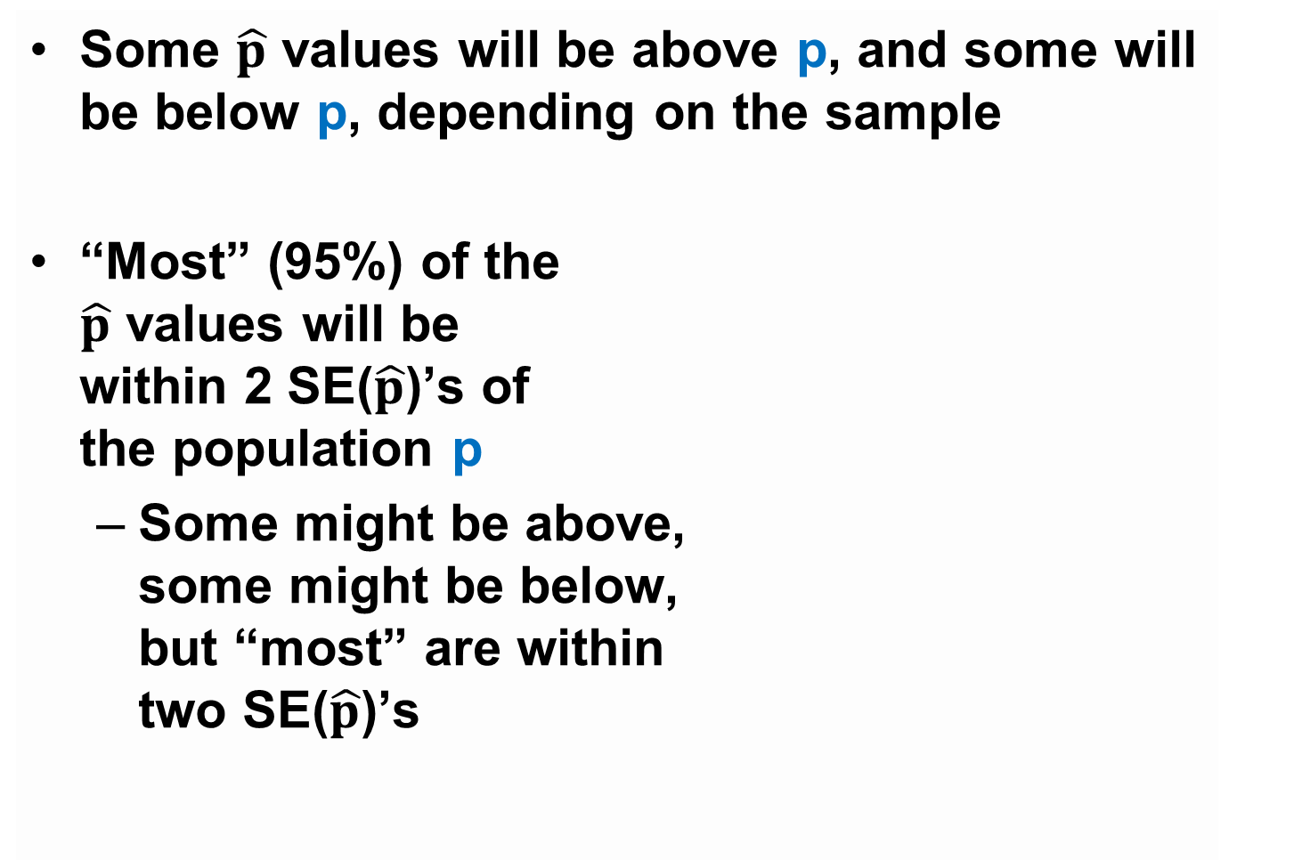
Some $\hat{p}$ values will be above p, and some will be below p, depending on the sample
“Most” (95%) of the $\hat{p}$ values will be within 2 SE($\hat{p}$)’s of the population p
Some might be above, some might be below, but “most” are within two SE($\hat{p}$)’s
Possible values of $\hat{p}$
p
E($\hat{p}$) = p
95%

Slide 42
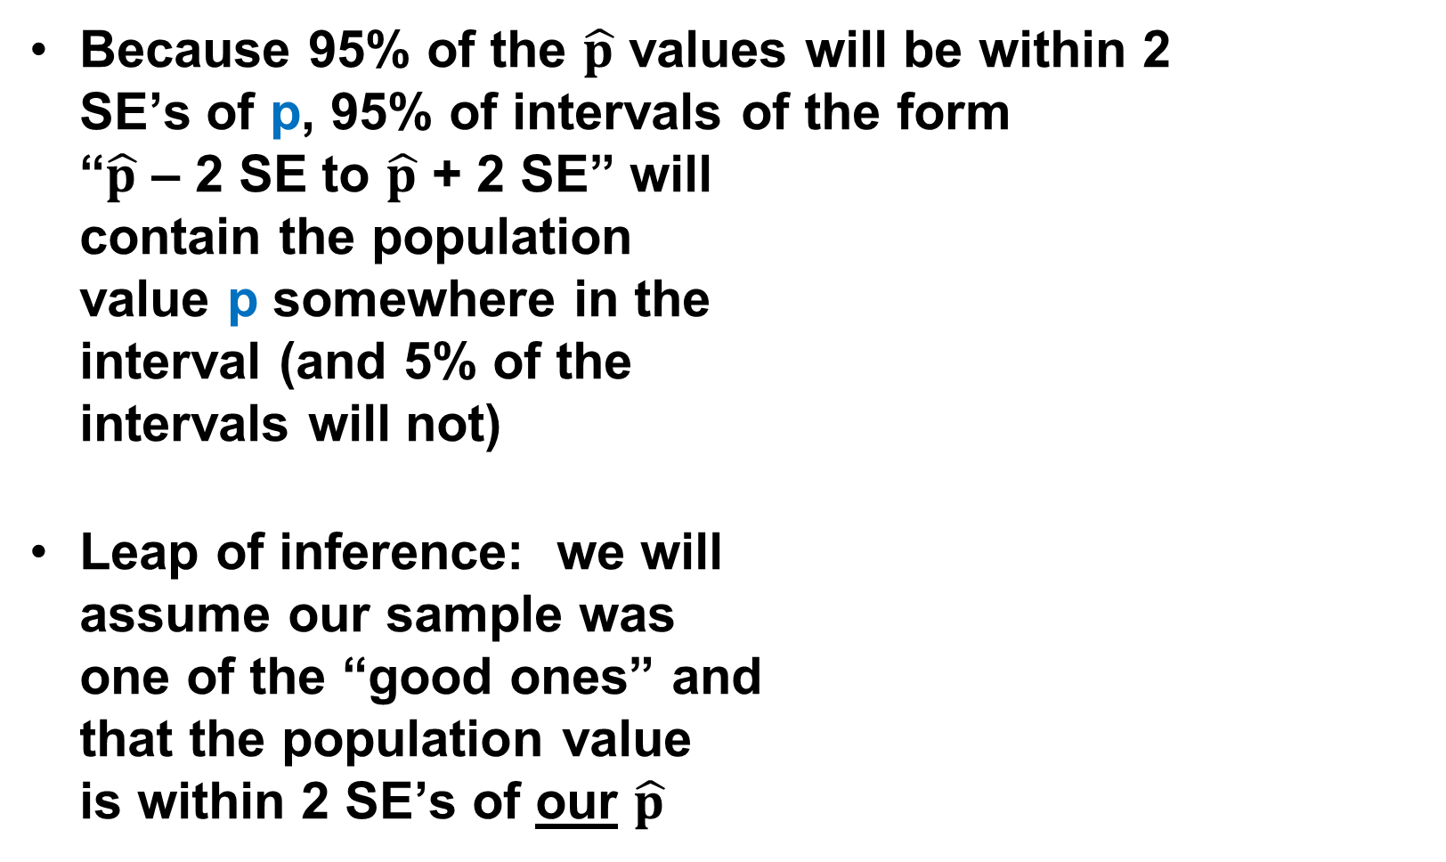
Because 95% of the $\hat{p}$ values will be within 2 SE’s of p, 95% of intervals of the form “$\hat{p}$ – 2 SE to $\hat{p}$ + 2 SE” will contain the population value p somewhere in the interval (and 5% of the intervals will not)
Leap of inference: we will assume our sample was one of the “good ones” and that the population value is within 2 SE’s of our $\hat{p}$
Possible values of $\hat{p}$
p
E($\hat{p}$) = p

Slide 43
Any specific interval is either “right” (contains p) or “wrong” (does not contain p)
“Most” of the intervals are “right”, because “most” of the intervals are “close” to p; but some intervals will be “wrong”!
For higher confidence, can use + 3 SE’s instead of + 1.96 SE’s, but there will always be a chance of a bad-luck sample
Possible values of $\hat{p}$
p
E($\hat{p}$) = p

Slide 44
(Confidence interval illustrator.xlsx)

Slide 45
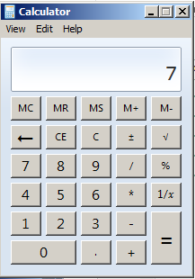
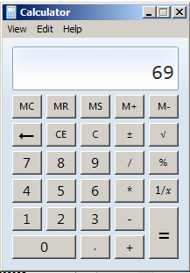
For any specific interval, the parameter either is in the interval or not; there is no “chance”
“Confidence” refers to the chance that a randomly-picked interval will contain the unknown population value
Analogy: unreliable calculator
What is 3 plus 4?
What is 6 times 9?

Slide 46
Special case: confidence intervals given zero failures
Given no failures in n independent trials, the (1–α) x 100% upper confidence limit for the failure rate is 1–(1–α)^{1/n}
Upper conf. limits can be bounded as
63% confidence → failure rate < 100% / n
90% confidence → failure rate < 230% / n
95% confidence → failure rate < 300% / n
Example: no failures in n=230 independent trials → 90% conf. limit for failure rate = 1%

Slide 47
Summary so far
Three questions to ask before doing statistical inference:
What is the population?
What is the parameter?
What do we want to know?
Could the parameter be equal to ___?
What are “reasonable guesses” for the parameter?
Properly done inference can answer interesting and important questions

Slide 48

http://www.aappublications.org/news/2017/09/12/Is-Antidepressant-Use-In-Pregnancy-Associated-With-Autism-Grand-Rounds-9-12-17
In a 2017 study, there were 2837 pregnancies where the child was exposed to antidepressants in utero. 58 of the children were subsequently diagnosed with autism.

Slide 49
http://www.aappublications.org/news/2017/09/12/Is-Antidepressant-Use-In-Pregnancy-Associated-With-Autism-Grand-Rounds-9-12-17
In a 2017 study, there were 2837 pregnancies where the child was exposed to antidepressants in utero. 58 of the children were subsequently diagnosed with autism.
Q1: what is a 95% confidence interval for the chance that a child exposed to antidepressants in utero will subsequently be diagnosed with autism?

Slide 50

http://www.aappublications.org/news/2017/09/12/Is-Antidepressant-Use-In-Pregnancy-Associated-With-Autism-Grand-Rounds-9-12-17
In a 2017 study, there were 2837 pregnancies where the child was exposed to antidepressants in utero. 58 of the children were subsequently diagnosed with autism.
Q1: what is a 95% confidence interval for the chance that a child exposed to antidepressants in utero will subsequently be diagnosed with autism?
Point estimate: $\hat{p}$ = 58 / 2837 = 0.020, or 2.0%
Est. SE($\hat{p}$) = sqrt(0.020 * 0.980 / 2837) = 0.00266
95% confidence → Z = 1.96
Approximate 95% CI for p: 1.52% to 2.57%

Slide 51
https://www.cdc.gov/ncbddd/autism/data.html
In a 2017 study, there were 2837 pregnancies where the child was exposed to antidepressants in utero. 58 of the children were subsequently diagnosed with autism.
Q2: is there “stat. significant” evidence that the rate of autism among children exposed to antidepressants in utero exceeds 1.47%?

Slide 52
https://www.cdc.gov/ncbddd/autism/data.html
In a 2017 study, there were 2837 pregnancies where the child was exposed to antidepressants in utero. 58 of the children were subsequently diagnosed with autism.
Q2: is there “stat. significant” evidence that the rate of autism among children exposed to antidepressants in utero exceeds 1.47%?
H₀: p₀ < 0.0147
p-value = P(58 or more in 2837 if H₀) = 0.009
In Excel: =1-BINOMDIST(57,2837,0.0147,TRUE)
Normal approx.: EV = 41.7, SE = 6.40, Z = 2.46
Conclusion: reject H₀, conclude p₀ > 0.0147

Slide 53
https://www.cdc.gov/ncbddd/autism/data.html
In a 2017 study, there were 2837 pregnancies where the child was exposed to antidepressants in utero. 58 of the children were subsequently diagnosed with autism.
Q3: do these data provide “statistically significant” evidence that exposure to antidepressants in utero causes rate of autism to increase from 1.47%?

Slide 54
Be careful when interpreting “statistically significant” results

Slide 55
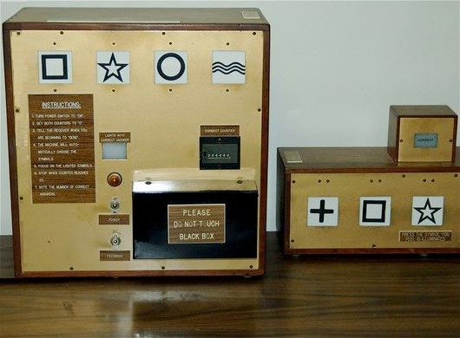
In 1976, Dr. Charles Tart ran an experiment at UC Davis to prove the existence of ESP

Slide 56
In 1976, Dr. Charles Tart ran an experiment at UC Davis to prove the existence of ESP
15 people were chosen who were thought to have ESP, and each of those 15 people made 500 predictions on “the Aquarius”, for a total of 7500 predictions

Slide 57
In 1976, Dr. Charles Tart ran an experiment at UC Davis to prove the existence of ESP
15 people were chosen who were thought to have ESP, and each of those 15 people made 500 predictions on “the Aquarius”, for a total of 7500 predictions
2006 of the 7500 predictions were correct

Slide 58
In 1976, Dr. Charles Tart ran an experiment at UC Davis to prove the existence of ESP
15 people were chosen who were thought to have ESP, and each of those 15 people made 500 predictions on “the Aquarius”, for a total of 7500 predictions
2006 of the 7500 predictions were correct
Could the results be explained by luck?

Slide 59
H₀: the 15 people did not have ESP, p = 0.25

Slide 60
H₀: the 15 people did not have ESP, p = 0.25
If H₀ were true,
EV(total count) = np = (7500)(0.25) = 1875
SE(total count) = sqrt[ np(1–p) ] = 37.5

Slide 61
H₀: the 15 people did not have ESP, p = 0.25
If H₀ were true,
EV(total count) = np = (7500)(0.25) = 1875
SE(total count) = sqrt[ np(1–p) ] = 37.5
p-value = P(2006 or more correct) = 0.000274
p = 1-BINOMDIST(2005,7500,0.25,TRUE)
Normal approx.: Z = (2005.5 – 1875) / 37.5 = 3.48

Slide 62
H₀: the 15 people did not have ESP, p = 0.25
If H₀ were true,
EV(total count) = np = (7500)(0.25) = 1875
SE(total count) = sqrt[ np(1–p) ] = 37.5
p-value = P(2006 or more correct) = 0.000274
p = 1-BINOMDIST(2005,7500,0.25,TRUE)
Normal approx.: Z = (2005.5 – 1875) / 37.5 = 3.48
Conclusion: p < 0.05, so reject H₀ … Charles Tart proved that ESP exists!
Or did he?

Slide 63
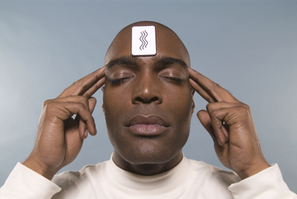
Next time: Lecture 6
Inference for Percentages
Homework 4 has been assigned

Slide 64
Gueguen, Jacob, and Lamy, “Love is in the air: Effects of songs with romantic lyrics on compliance with a courtship request”, Psychology of Music 2009; 39; 303
In one study, “18-20-year-old single female participants … interacted with a young male confederate in a marketing survey. During a break, the male confederate asked the participant for her phone number.”
35 of the 87 women gave their phone number
Q1: if these 87 women are a simple random sample of all 18-20-year-old single females, what is a 90% confidence interval for the percentage of single women who would give their phone number after a short interaction?

Slide 65
Gueguen, Jacob, and Lamy, “Love is in the air: Effects of songs with romantic lyrics on compliance with a courtship request”, Psychology of Music 2009; 39; 303
In the study, the women were put into waiting rooms chosen at random. Half heard music with romantic lyrics; half heard music with neutral lyrics. The interaction with the young male began five minutes later.
35 of the 87 women gave their phone number
43 heard neutral music: 12 gave phone #
44 heard romantic music: 23 gave phone #
The difference in rates was 28% versus 52%. What would the null hypothesis be?

Slide 66
Gueguen, Jacob, and Lamy, “Love is in the air: Effects of songs with romantic lyrics on compliance with a courtship request”, Psychology of Music 2009; 39; 303
In the study, the women were put into waiting rooms chosen at random. Half heard music with romantic lyrics; half heard music with neutral lyrics. The interaction with the young male began five minutes later.
35 of the 87 women gave their phone number
43 heard neutral music: 12 gave phone #
44 heard romantic music: 23 gave phone #
Can the difference in rates (28% versus 52%) be explained by luck? What is the p-value?

Slide 67
Does the flu vaccine cause miscarriages? In one study, 48 women who had miscarriages were asked if they had had a flu shot in the 28 days prior to the miscarriage: 24 had.
Another 48 women who had not had miscarriages were asked if they had a flu shot in the 28 days prior to the birth of their child: 15 of them had.
Per the CDC, the overall rate of flu vaccinations among adults was 43.3%

Slide 68
What percent of U.S. voters know the three branches of government?

